Slide 1
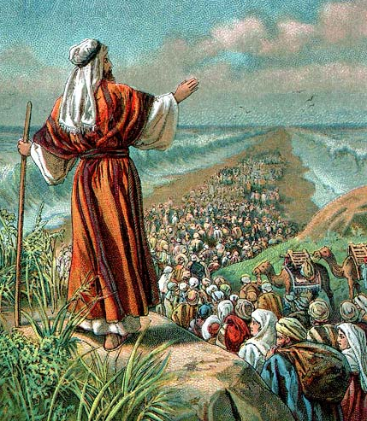
Quarter 3 Invasion, Conquest & Judges
Auditorium
Lesson 2
2023
Notes:
This Quarter with each section of scripture ask yourself two questions to prepare for class:
Why did God choose to write this for the original audience?
Why did God choose to preserve it for us to read and study today?
Example Deut. and the retelling of the Law.
What was the Law to the original audience? - How a Jew was to live and the Laws they were to live by. Are we to live by the same commands? Then why save it for us? We learn aspects of His Character, and His expectations for all mankind throughout the Old Testament. I.e. how is it a tutor to bring us to Christ? So, these two questions separate why we study Old Testament scripture. When we learn something, we can ask was this teaching nailed to the cross. If so, it is for the original audience. If it wasn’t we should still pay attention today.

Slide 2
Disclaimer
Much of the material used tonight is copyrighted
I have purchased or have permission to use
I am thankful to those who have traveled so we can better understand
Satellite Bible Atlas, Appian Media, Leon Maulden
Notes:
The Children of Israel faces (Put yourselves in the peoples place):
The leader they trust is dead.
They are morning the loss of Moses.
Joshua has not been proven as a leader.
The battles to come.

Slide 3
Put Yourself In The People’s Shoes
Notes:
The Children of Israel faces (Put yourselves in the peoples place):
The leader they trust is dead.
They are morning the loss of Moses.
Joshua has not been proven as a leader.
The battles to come.

Slide 4
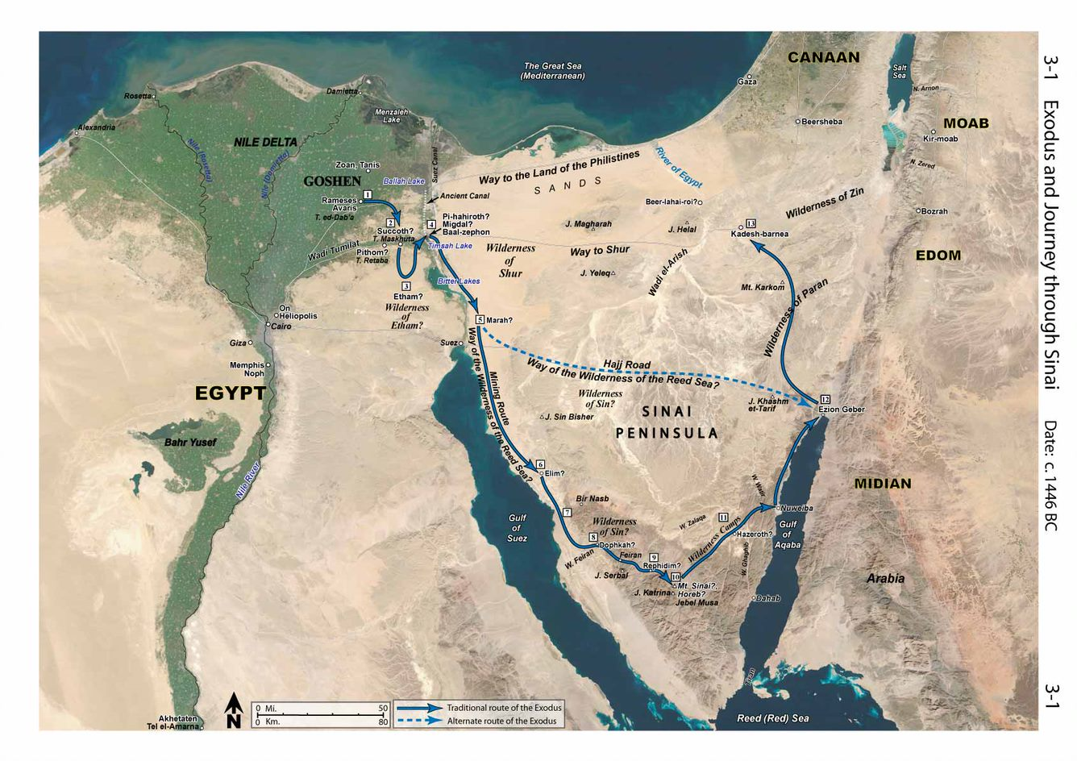

Slide 5
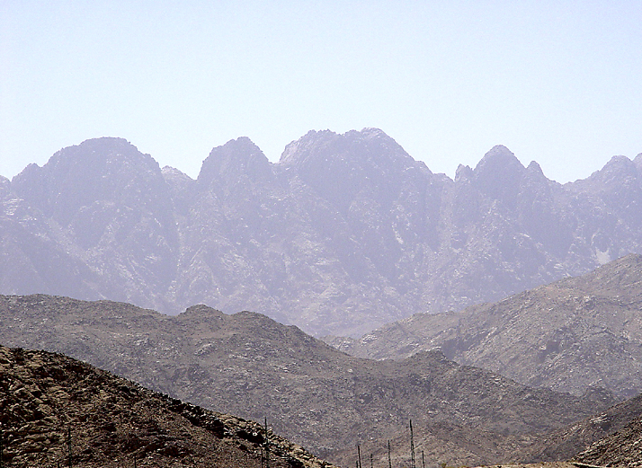
Notes:
Sinai

Slide 6
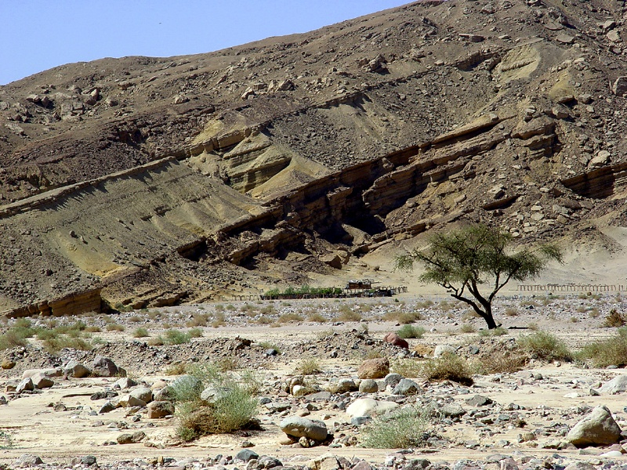
Notes:
Sinai

Slide 7
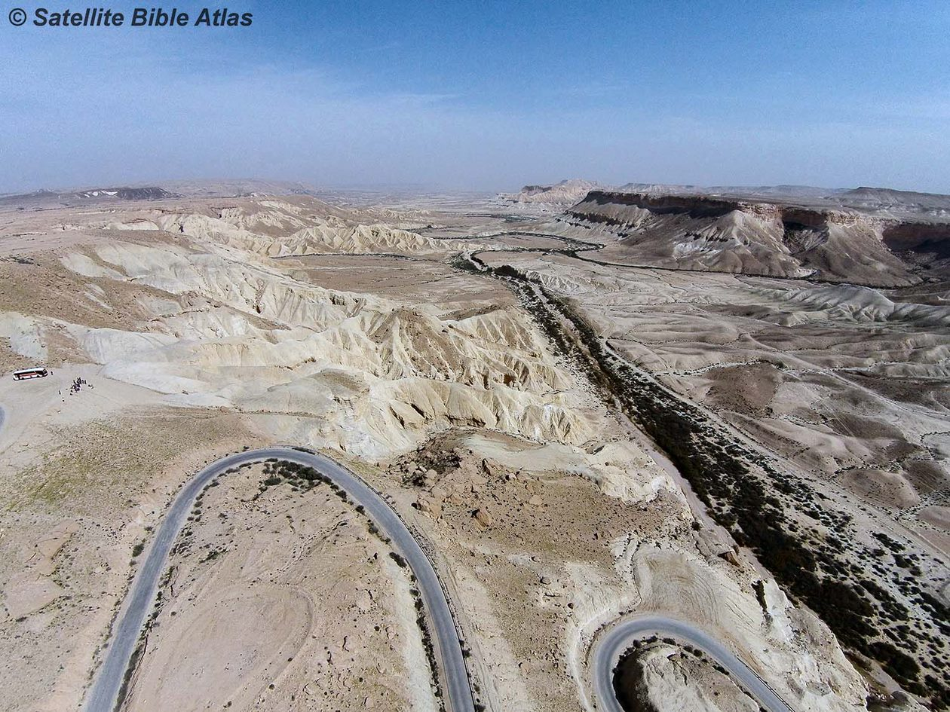

Slide 8
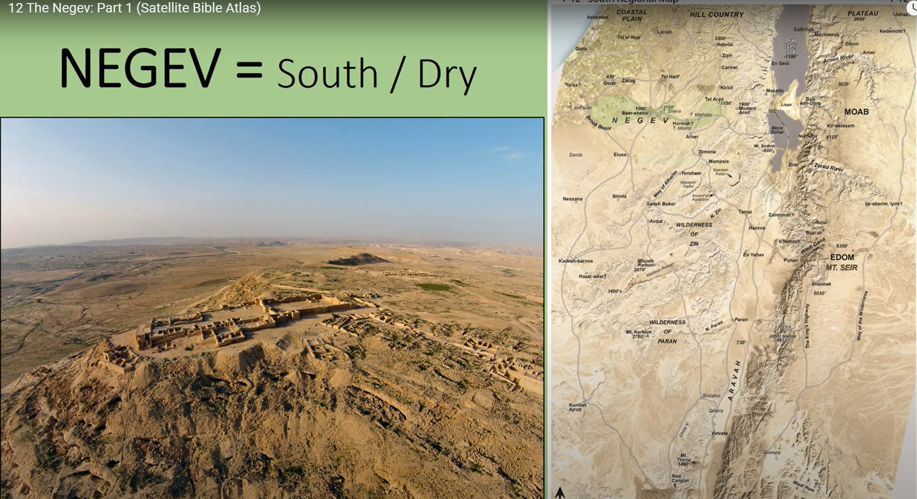
Spies @ Kadesh

Slide 9
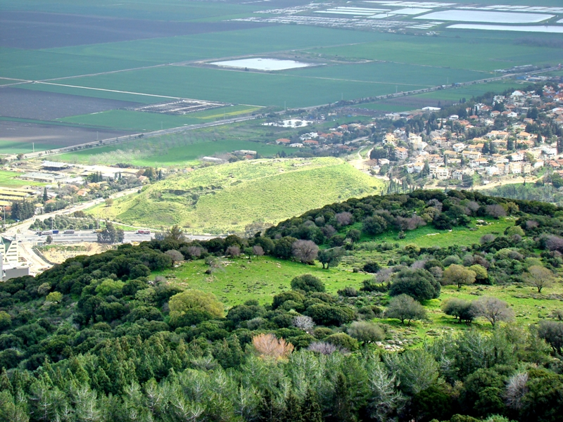
Spies

Slide 10
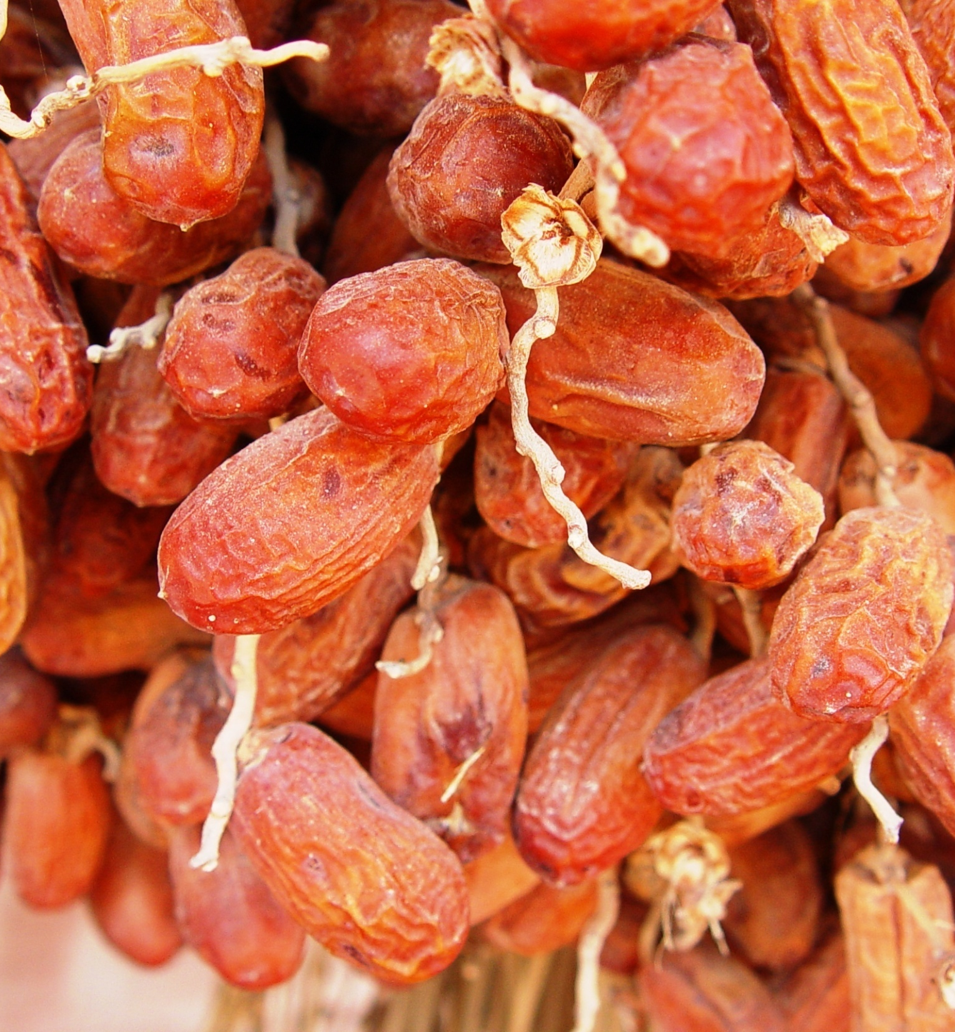
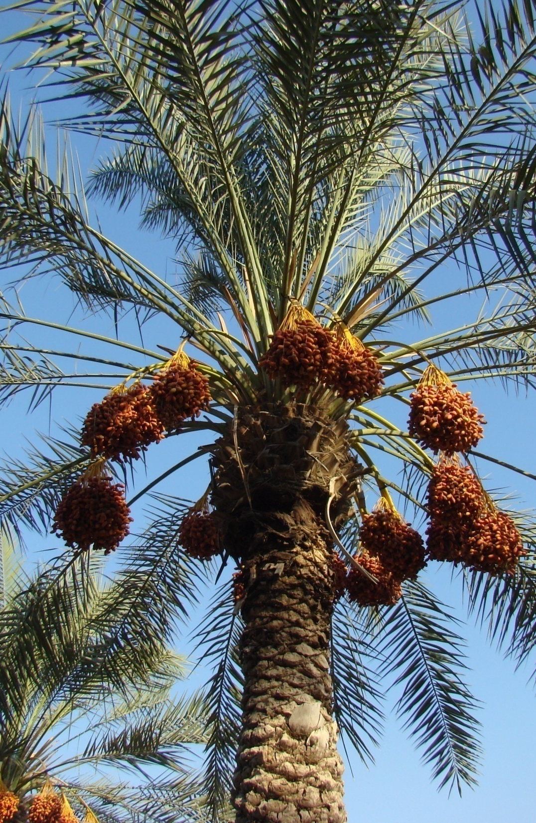

Slide 11
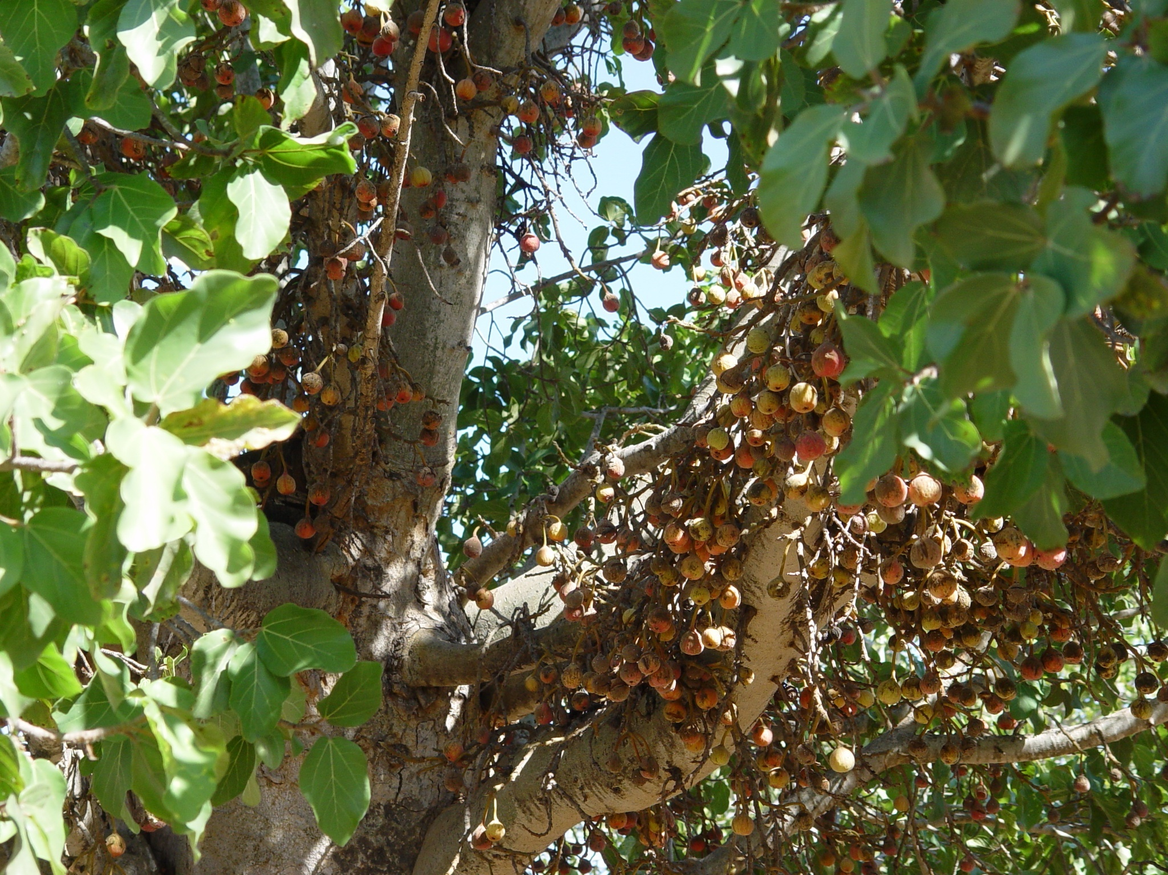
Sycamore Fruit
Notes:
Amos 7:14 “I was no prophet, Nor was I a son of a prophet, but I was a herdsman And a tender of sycamore fruit.”

Slide 12
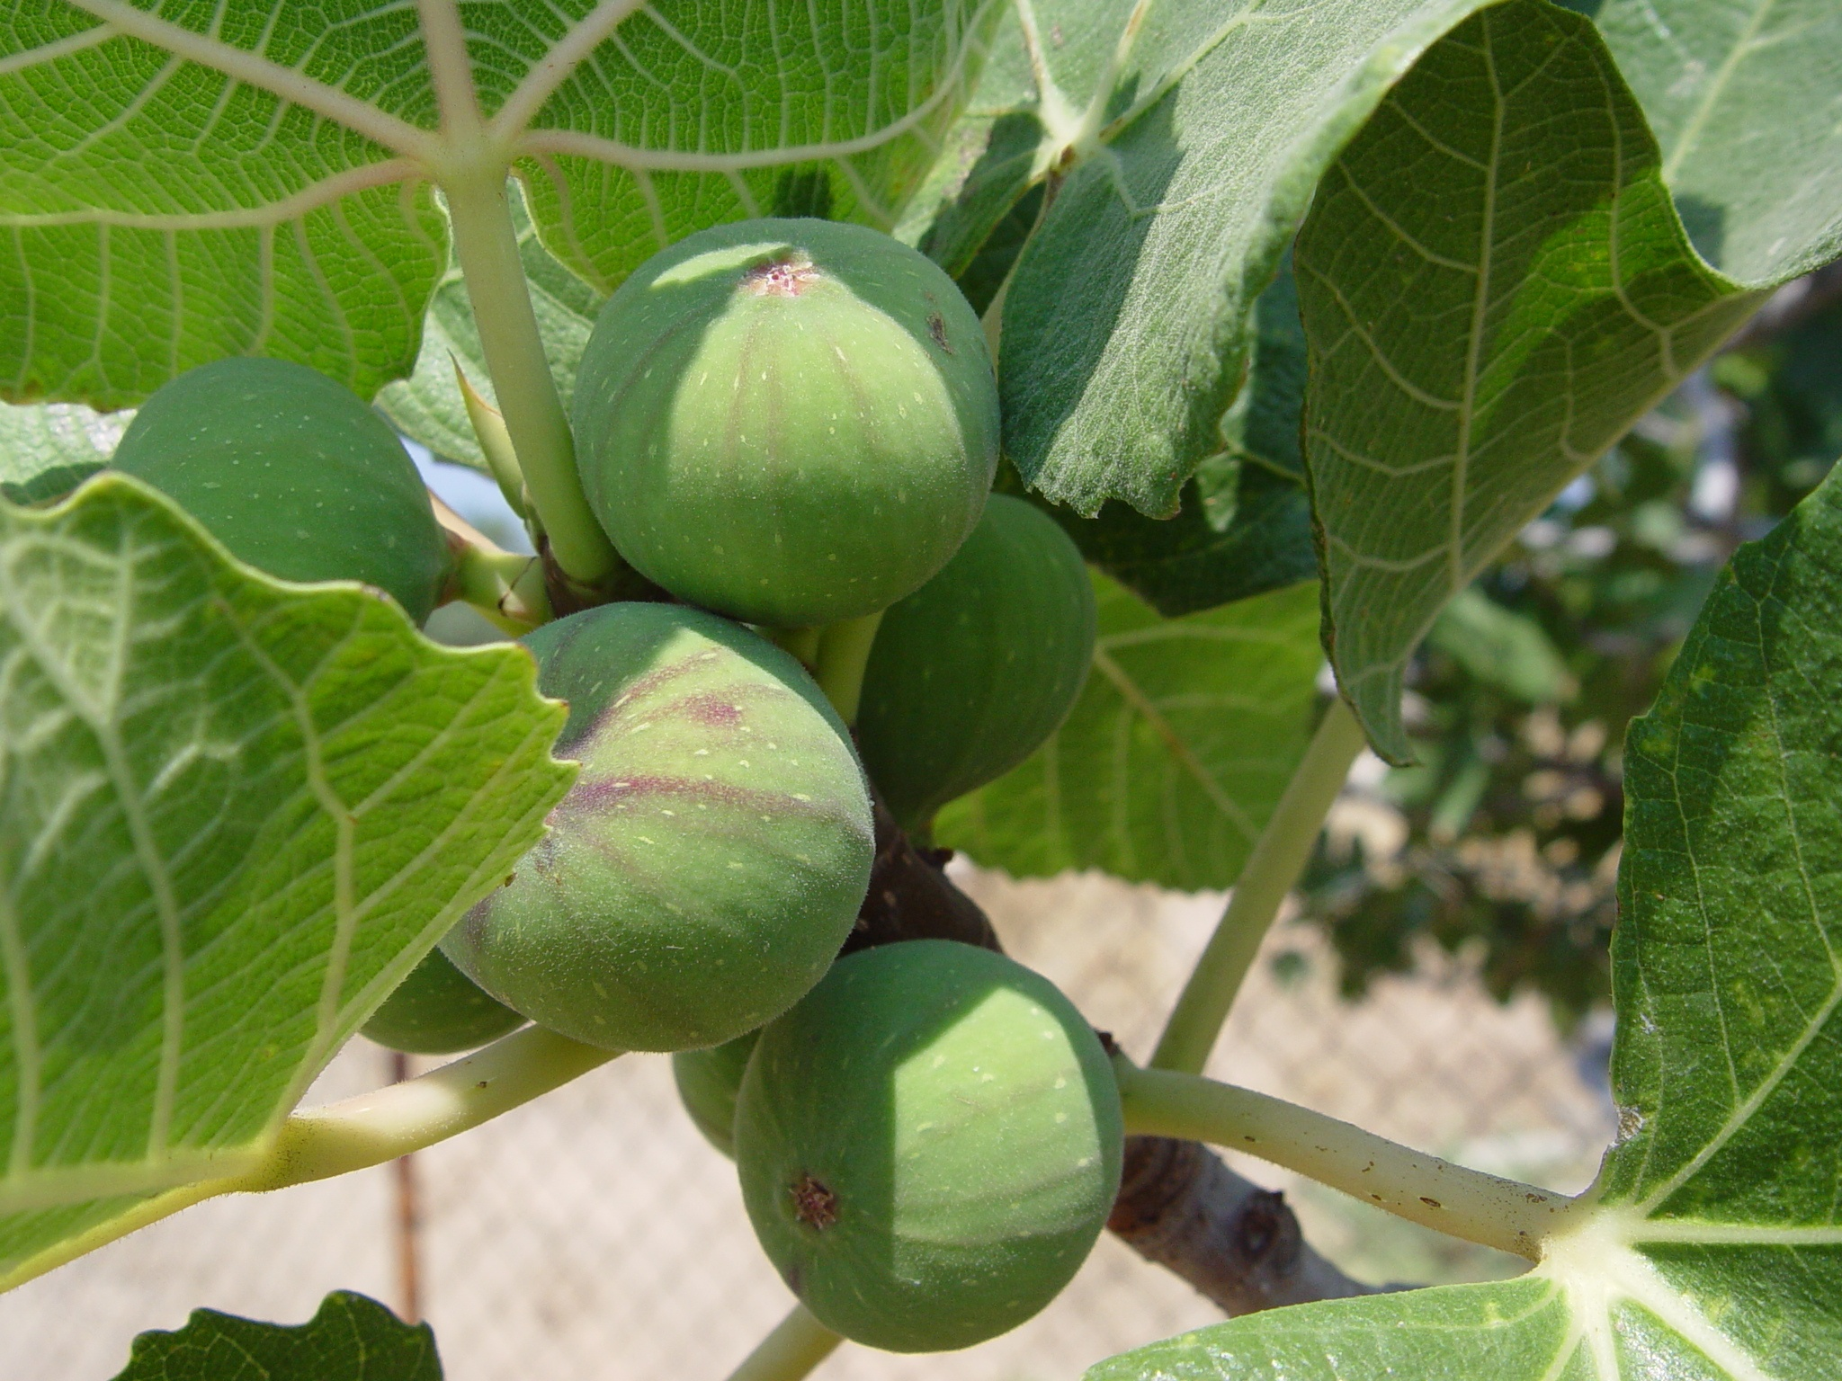
Figs
Notes:
Figs at Corinth July ‘06

Slide 13
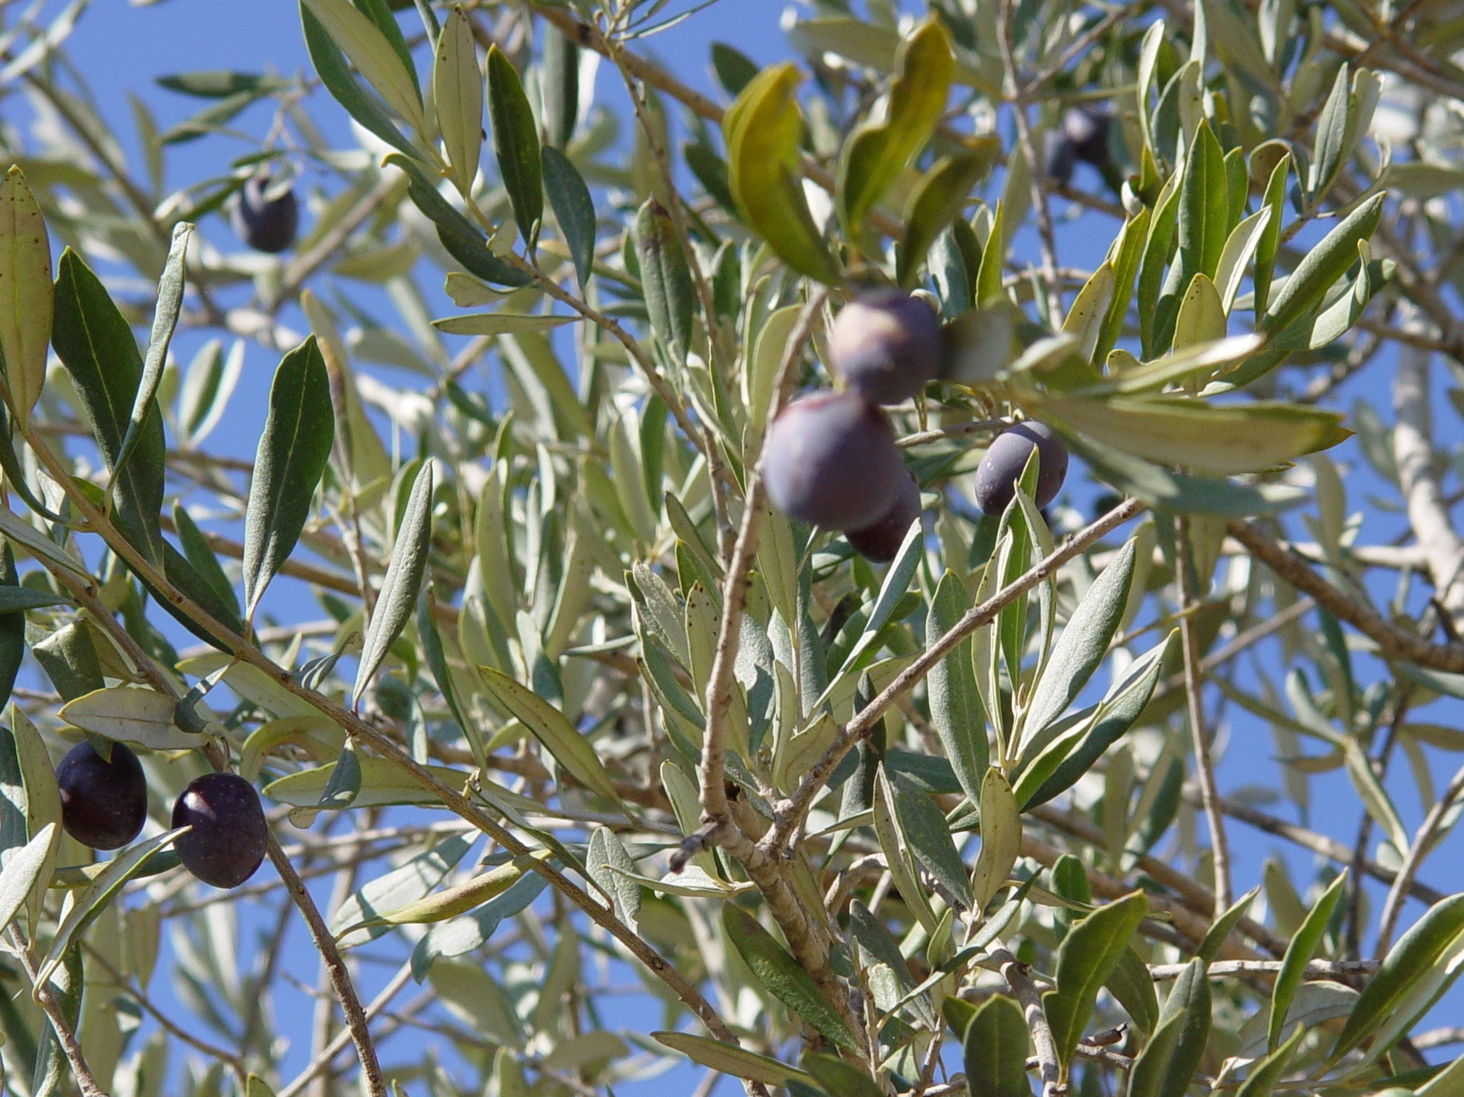
Olives
Notes:
Olive tree

Slide 14
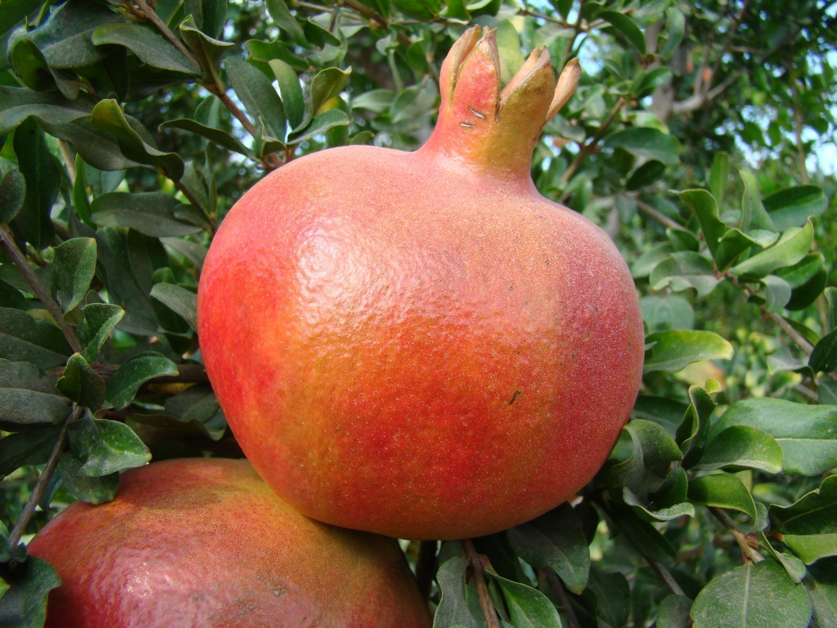
Pomegranate
Notes:
SoS 4:3 Your lips are like a scarlet thread, And your mouth is lovely. Your temples are like a slice of a pomegranate Behind your veil. Song of Sol. 4:3

Slide 15
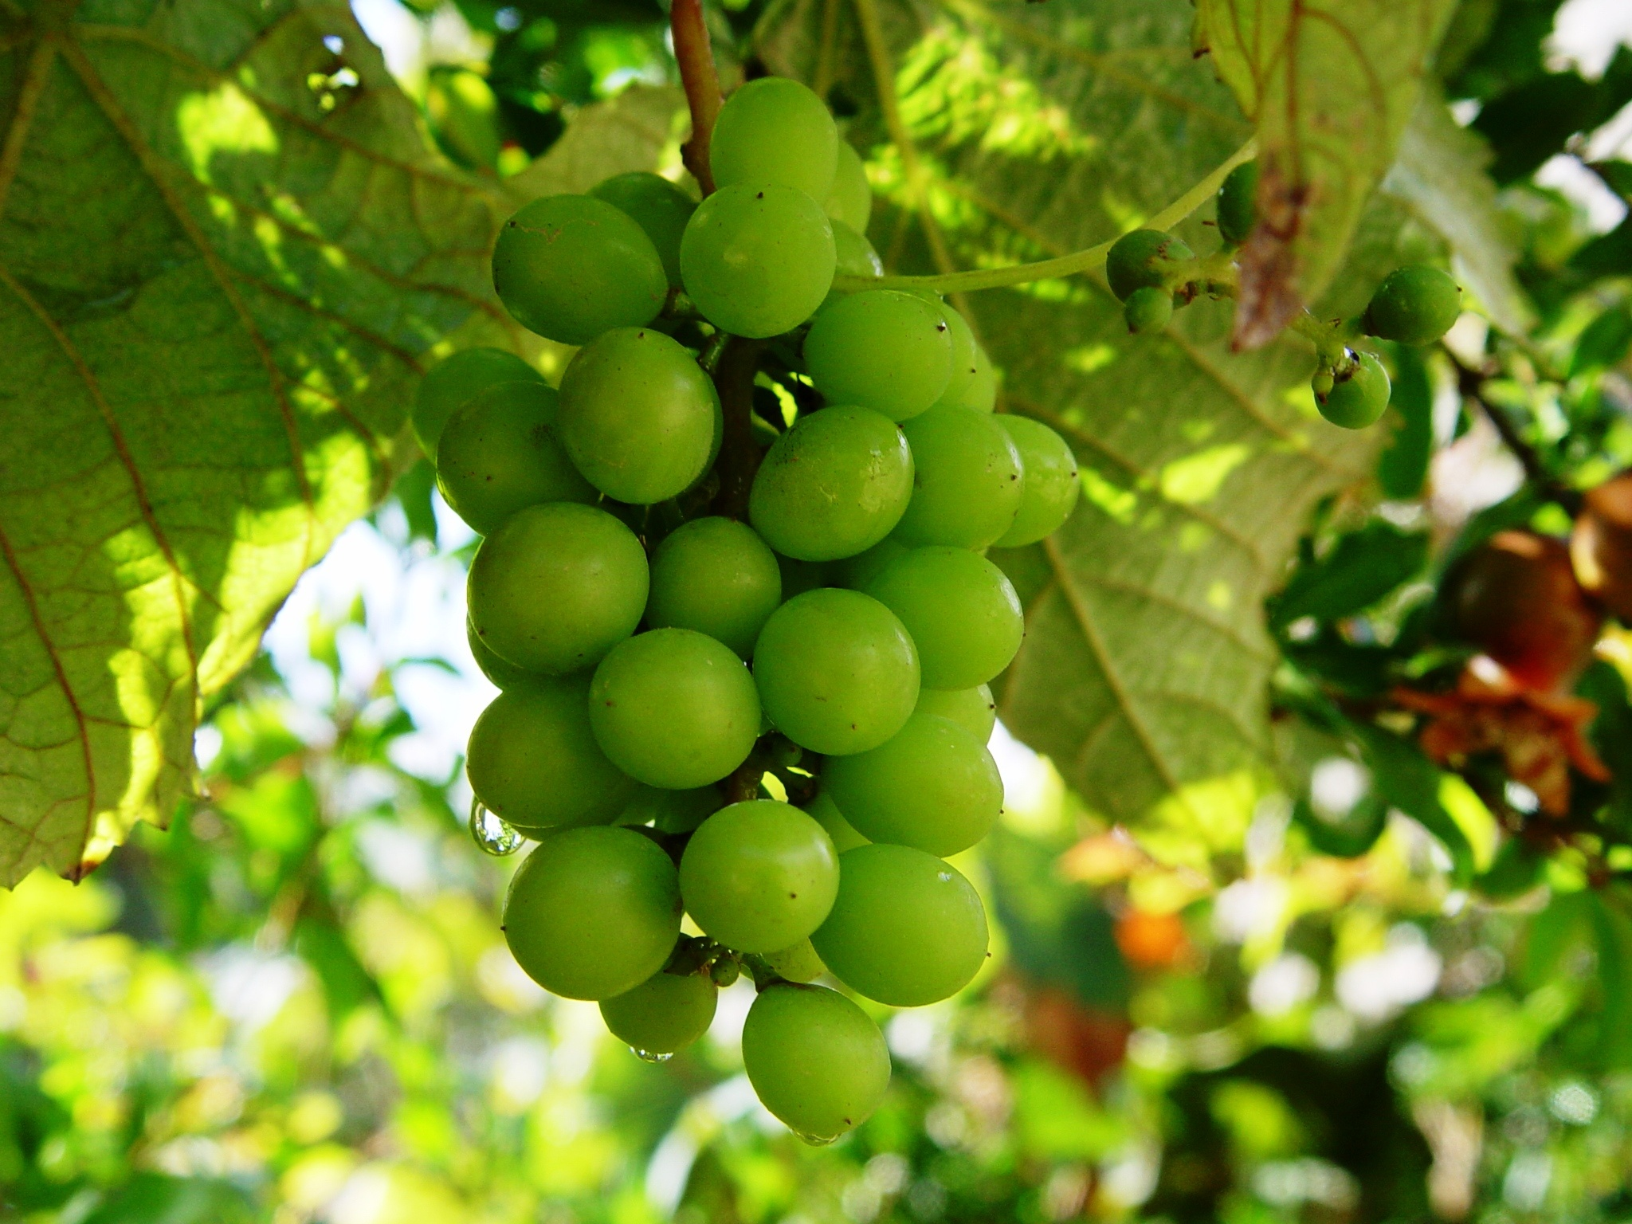
Grapes
Notes:
Grapes—fruit of the vine
Bethphage

Slide 16
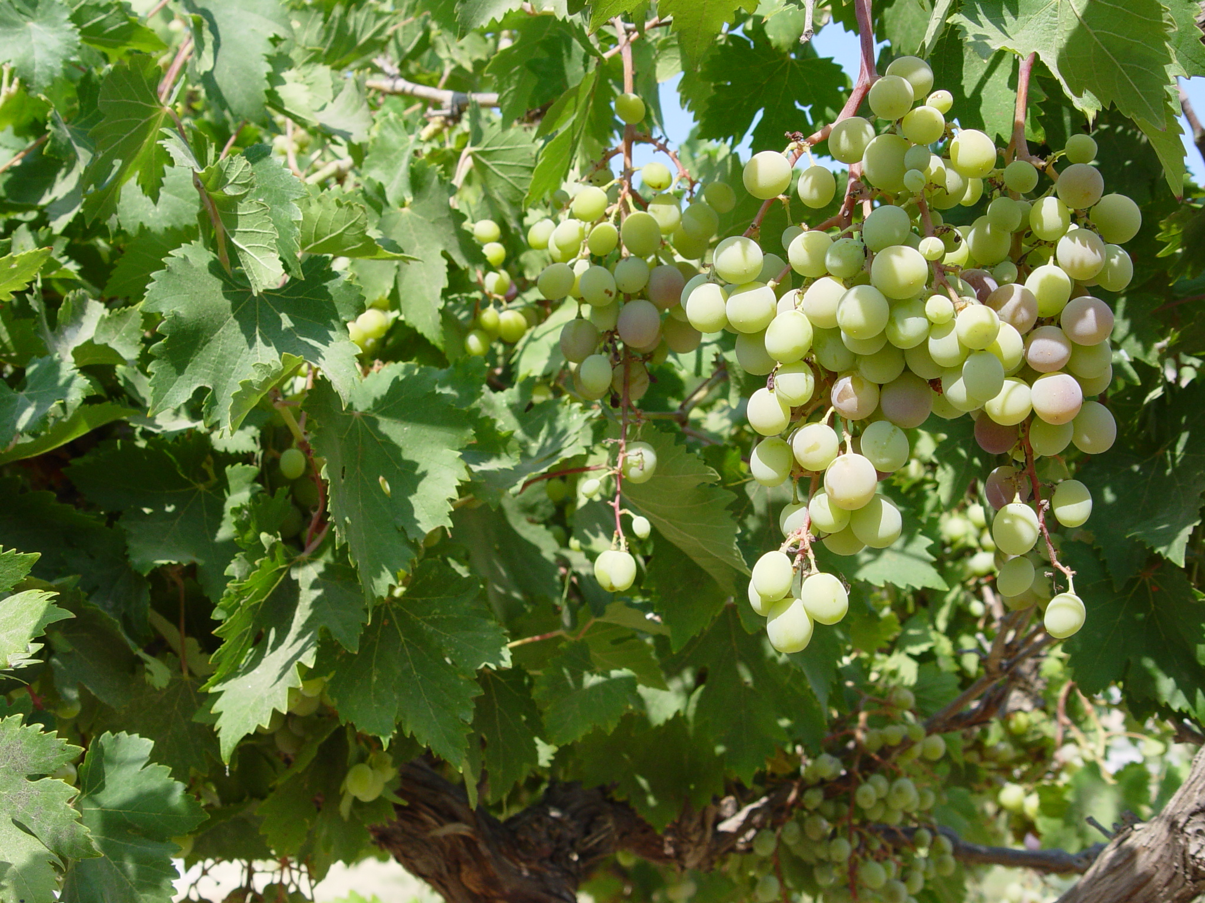
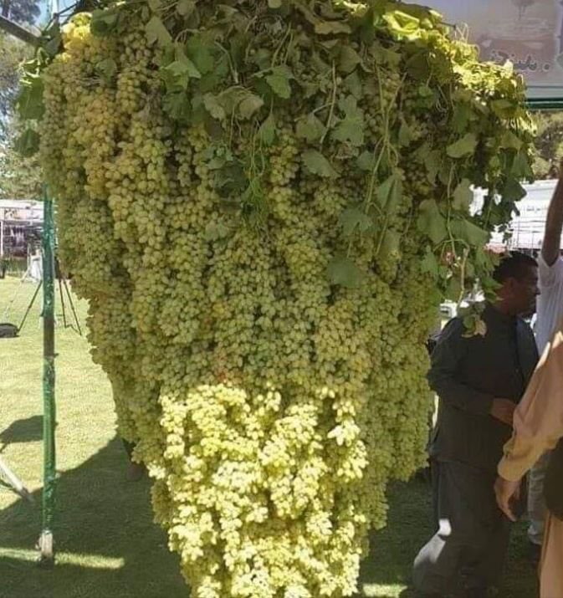
Notes:
Grapes

Slide 17
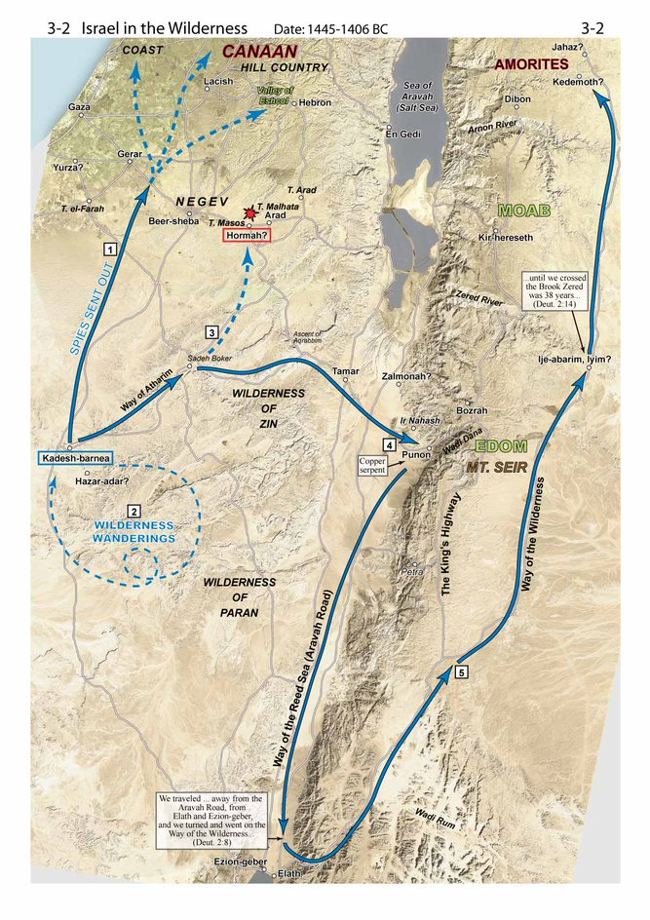
Put Yourself In The People’s Shoes
How Did they Respond?
Notes:
The Children of Israel faces (Put yourselves in the peoples place):
The leader they trust is dead.
They are morning the loss of Moses.
Joshua has not been proven as a leader.
The battles to come.

Slide 18
Put Yourself In The People’s Shoes
Could they have entered 40 years ago?
By this they may know
Rahab
Circumcision
Notes:
The Children of Israel faces (Put yourselves in the peoples place):
The leader they trust is dead.
They are morning the loss of Moses.
Joshua has not been proven as a leader.
The battles to come.

Slide 19
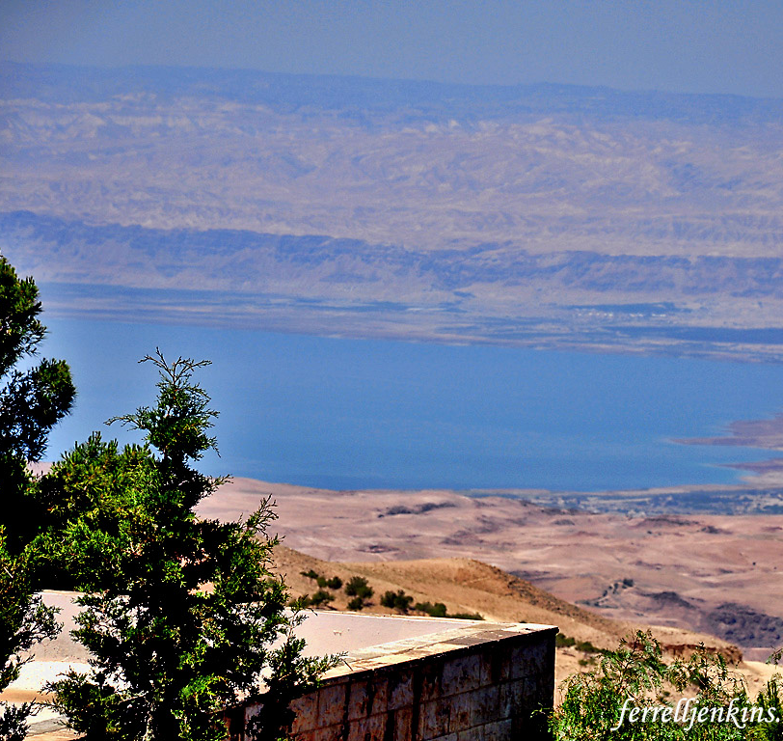
Put Yourself In Moses’ Shoes
The Book of Deuteronomy
(30:15-19)
Notes:
Pictures is from Ferrell Jenkins and it is a view across the Joran while standing on Mt. Nebo
Moses faces Death (Put yourself in Moses place)
You have put everything on the life for these people and saved them from destruction several times.
You are fearful they will fail as soon as you are gone.
Because of them, he cannot go into the land.
Deuteronomy is somewhat a highlight of what God wants them to know given from the point of view of an old man on his deathbed and what he wants to tell his family before he passes away.
Do these messages normally talk about physical things or the intangibles of life that cannot be bought or sold?

Slide 20
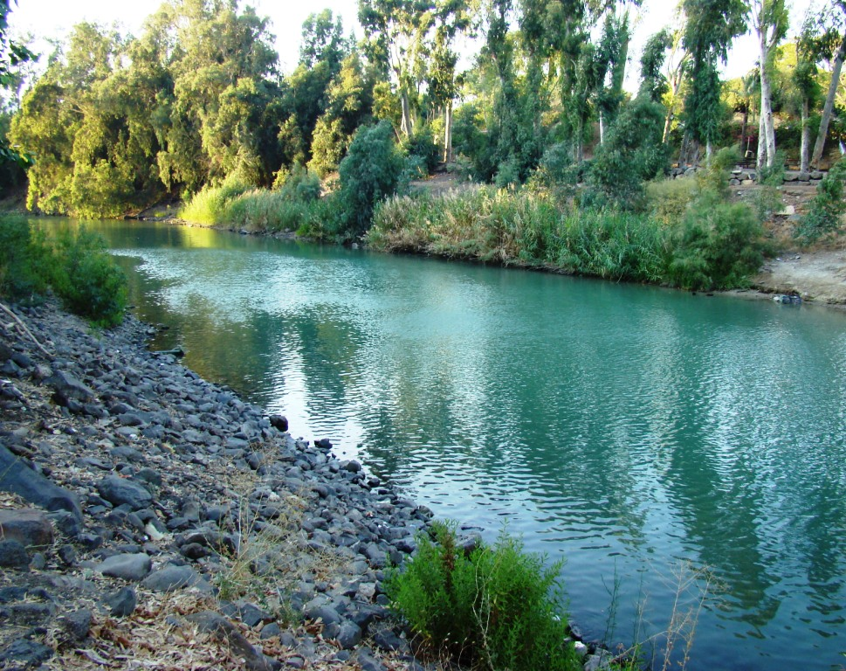
Notes:
Jordan River just south of Sea of Galilee

Slide 21
Put Yourself In Joshua’s Shoes
Be Strong and of Good Courage
Notes:
Joshua faces (Put yourselves in Joshua's place):
He has never lead the people before. (But has he been a leader?)
He is probably nervous as to if the people will follow him.
He could be scared of the battles to come.
He has just lost his leader in Moses.

Slide 22
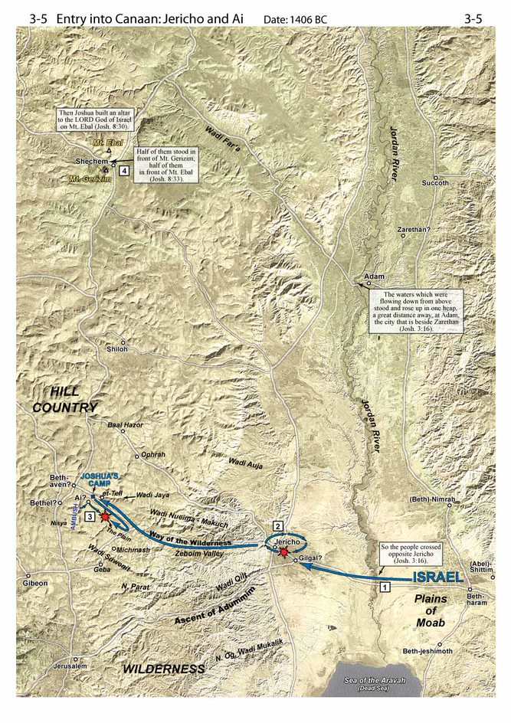

Slide 23
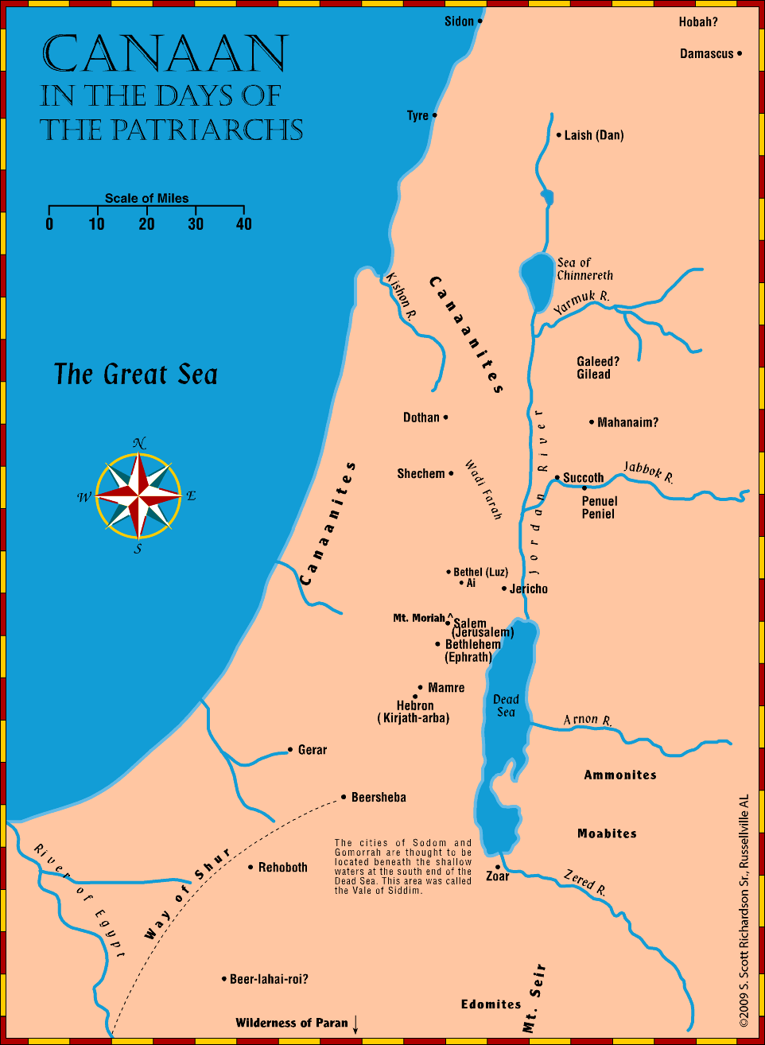
Major Tribes
(Genesis 10:6, 15-20)
Hivites
Canaanites
Amorites
Hittites
Girgashites
Perizzites
Hivites
Jebusites
Girgashites
Moab
Ammonites
Edomites
Canaanites
Amorites
Jebusites
Perizzites
Hittites
Giants in the Land

Slide 24
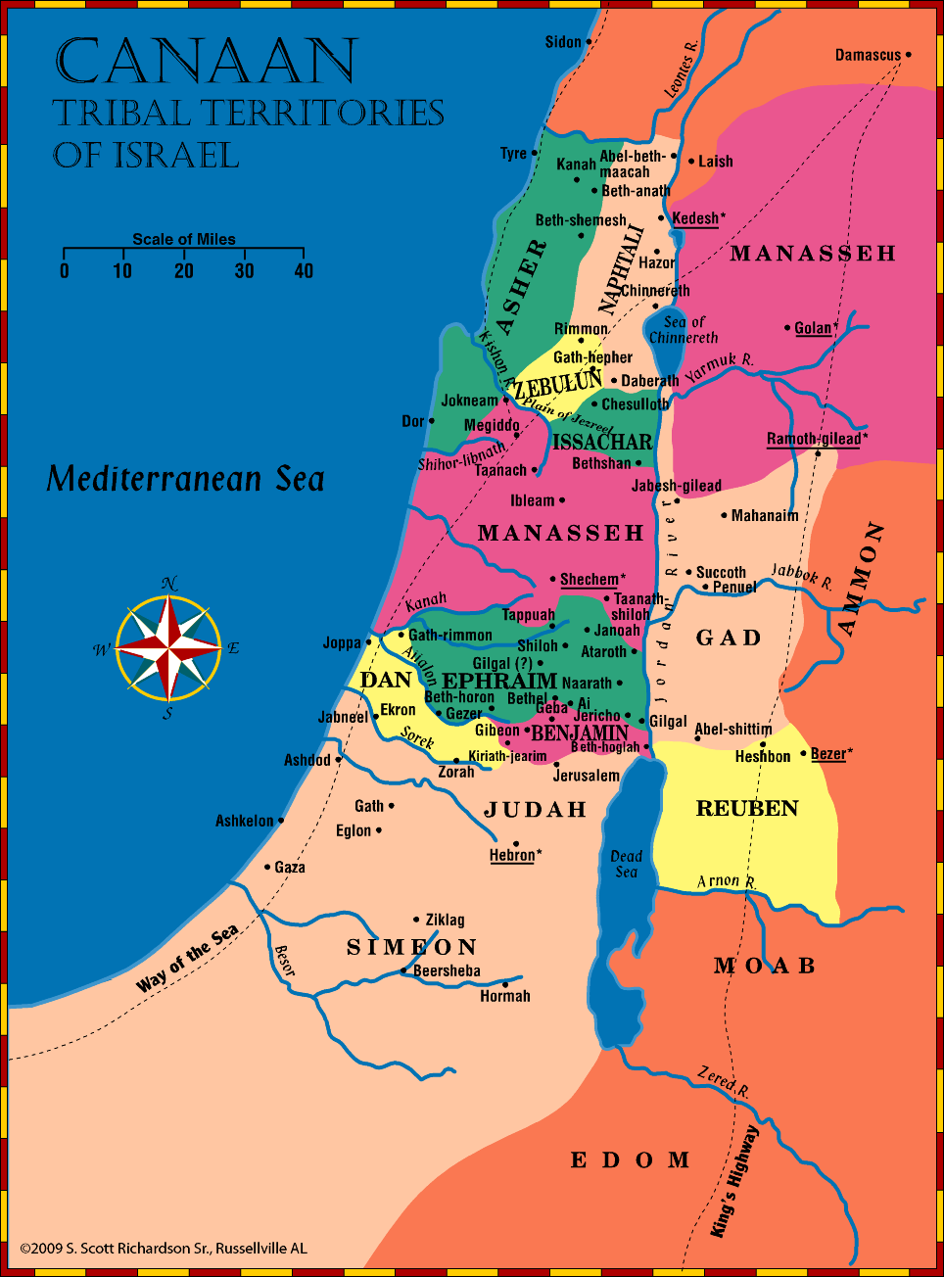
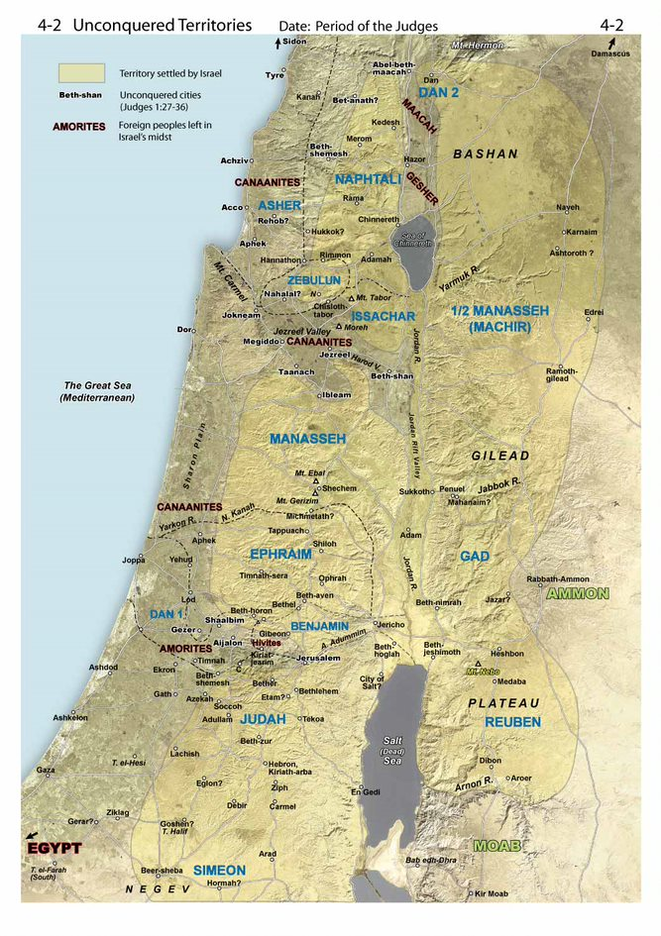
Notes:
From Satellite Bible Atlas
Judges 1:27-36 describes cities and land which the Israelites were not able to settle. Manasseh was unable to drive out the Canaanites from the important Jezreel Valley cities of Beth-shan, Taanach, Ibleam, Megiddo, and from the coastal city of Dor. Canaanites also persisted in the Jezreel Valley cities of Zebulun. Asher unsuccessfully settled the northern coast and "lived among the Canaanites, the inhabitants of the land." Naphtali could not drive out the Canaanites of some of the cities in Upper Galilee. Around the Sea of Galilee and Golan "Israel did not dispossess the Geshurites or the Maacathites; for Geshur and Maacath live among Israel until this day" (Joshua 13:13). In the Coastal Plain, Ephraim could not drive out the Canaanites who dwelt in the strategic city of Gezer. The Amorites pushed the Danites out of the Coastal and Shephelah cities – causing some of the tribe of Dan to move north. Although Judah had some early victories in the Coastal Plain, he was not able to hold and inhabit that territory (Judges 1:18-19). In the Hill Country around Jerusalem the Hivites by stratagem had made a treaty with Israel (Joshua 9) and lived in the cities of Gibeonand Kiriat-jearim. Although Judah had attacked and burned Jerusalem (Jebus), Jebusites re-inhabited and remained in the city (Judges 1:8, 21). In summary, Israel was not able to settle three areas: a.The plains, including the northern and southern Coastal Plains and the Jezreel Valley. There is literary and archaeological evidence that the Canaanites in the plains had the support of Egypt. For military and economic purposes Egyptian operations in Canaan focused on asserting control over the routes in the plains (Maps 3-8 and 4-4). b.Parts of Golan and the Hulah Valley north of the Sea of Galilee. c.A corridor to Jerusalem from the Coastal Plain. On the other hand, the areas Israel had been successful settling were the Hill Country territories of Judah, Ephraim and Manasseh, some of Galilee, and Transjordan.

Slide 25
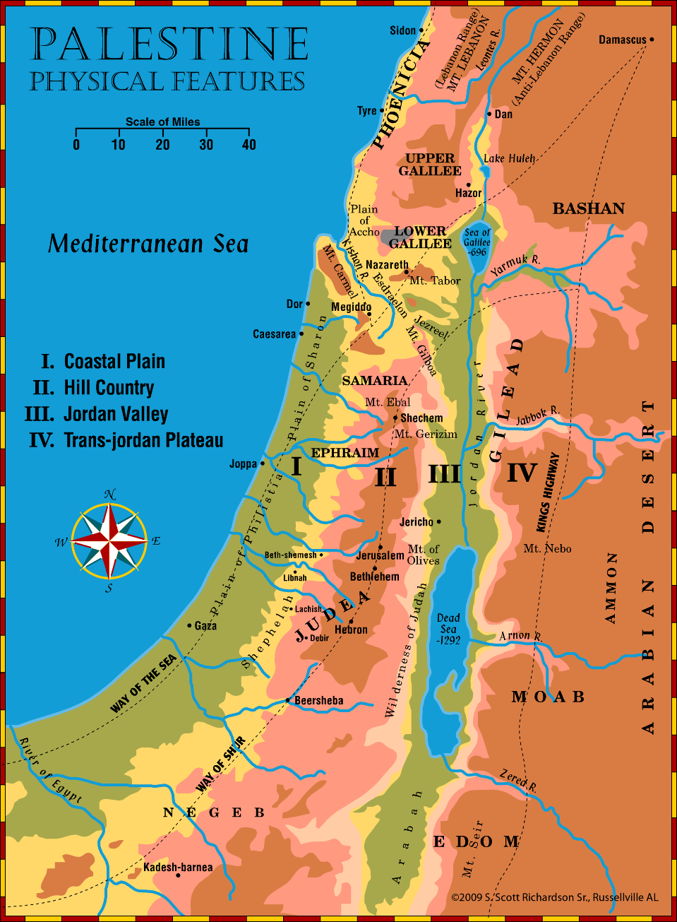
Highways & Geography

Slide 26
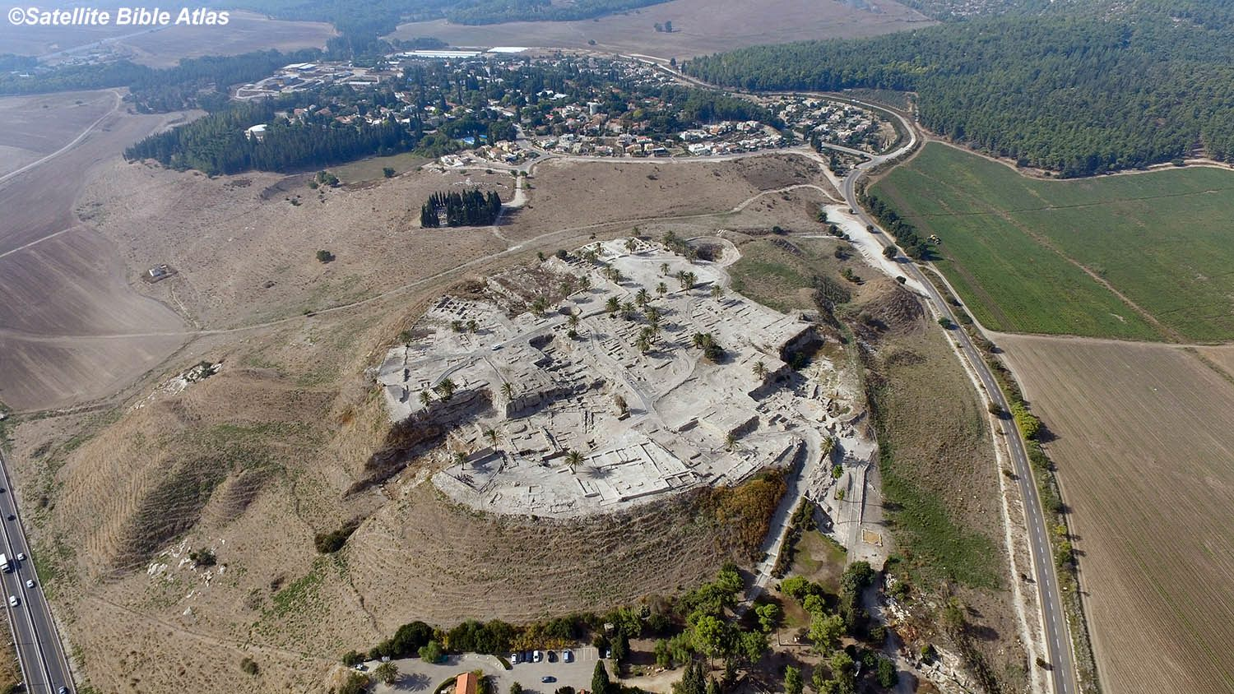
Megiddo

Slide 27
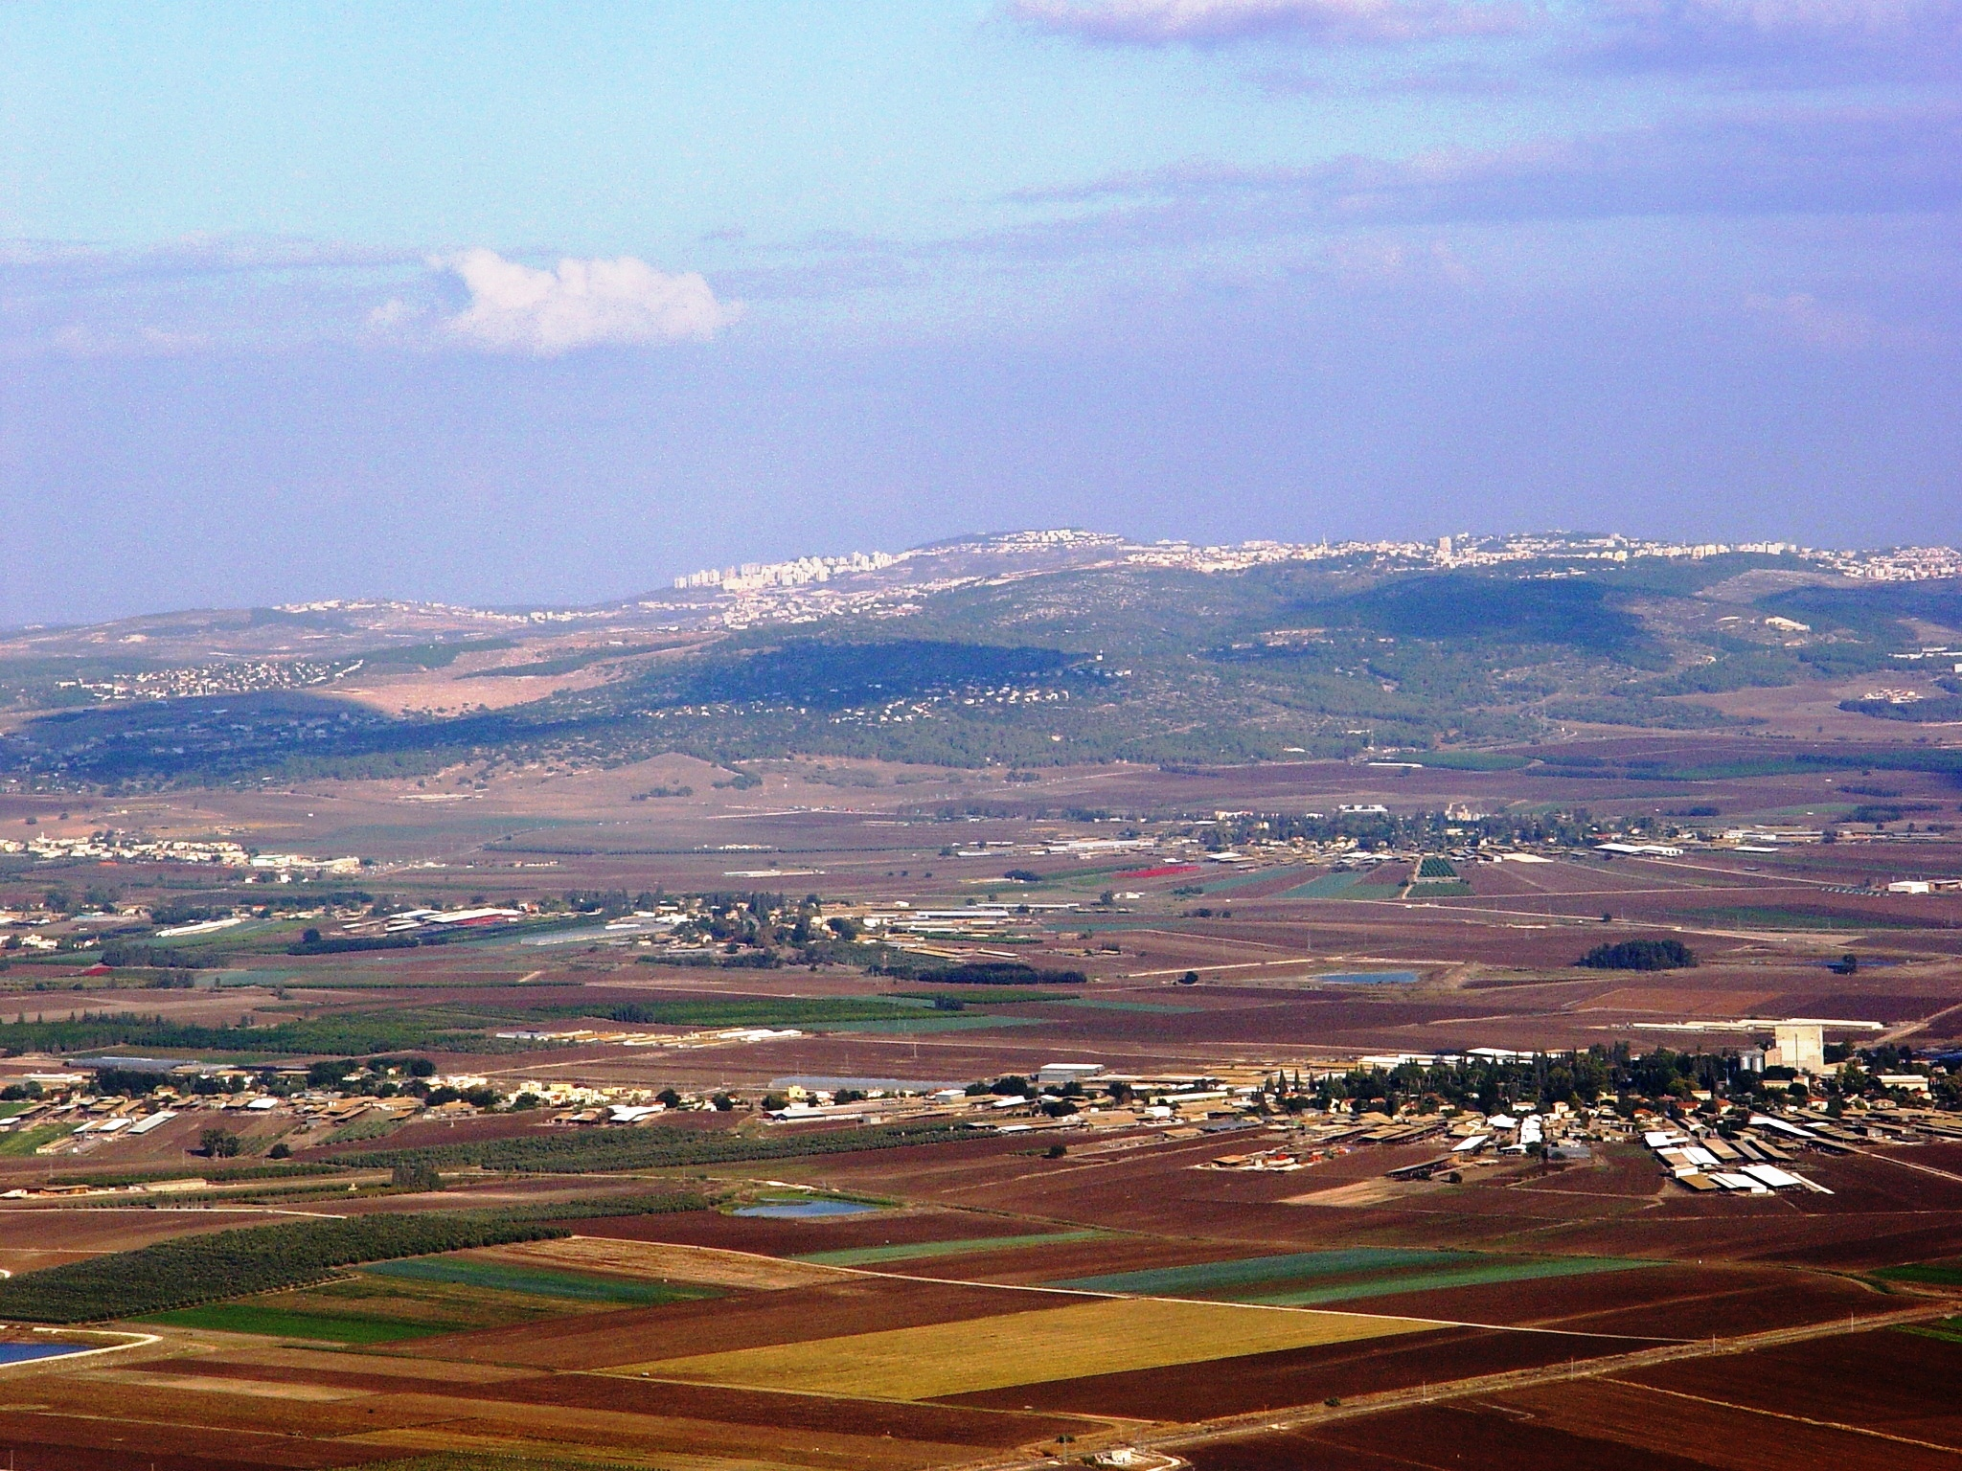
Notes:
Jezreel valley from Mt Carmel

Slide 28
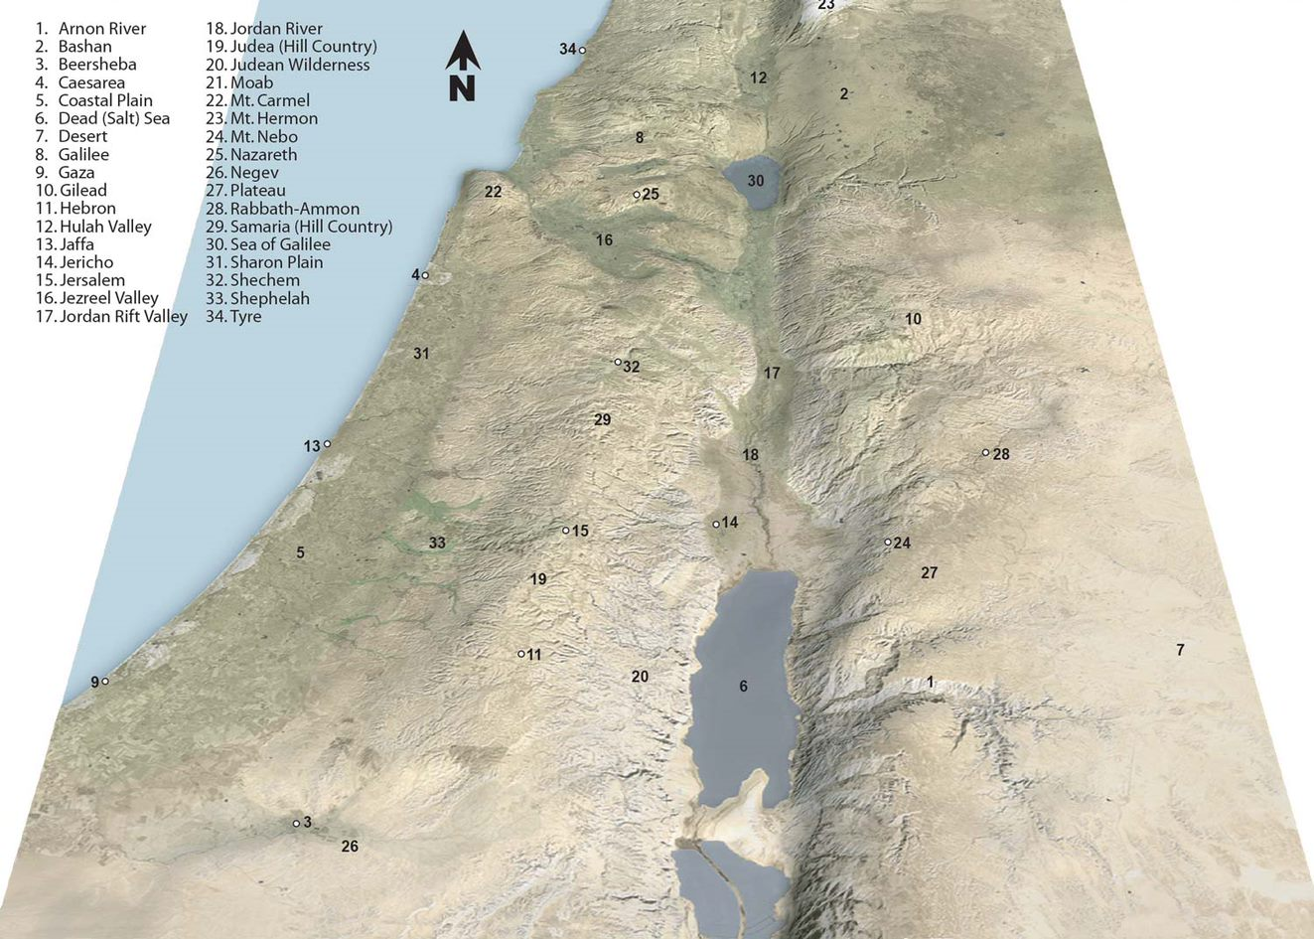

Slide 29
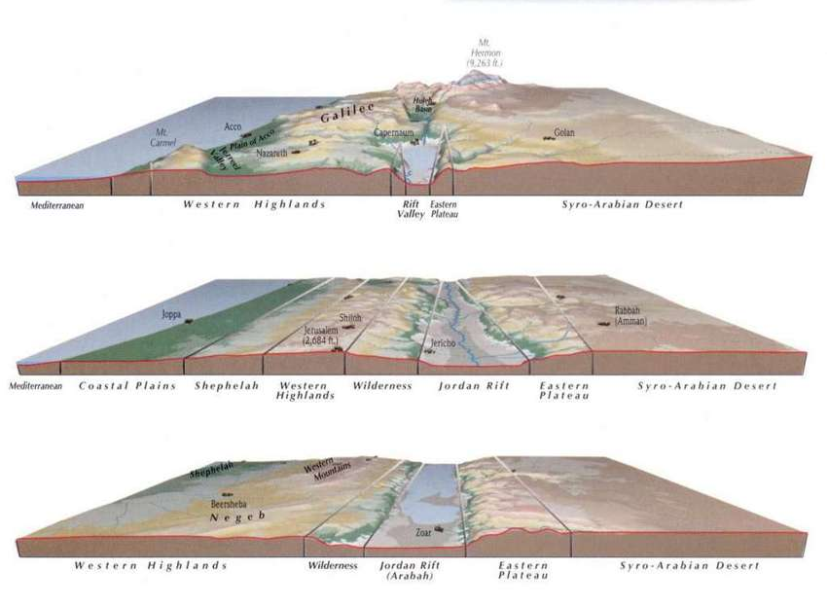
Notes:
Cross-section of Palestine. North-Central-South

Slide 30
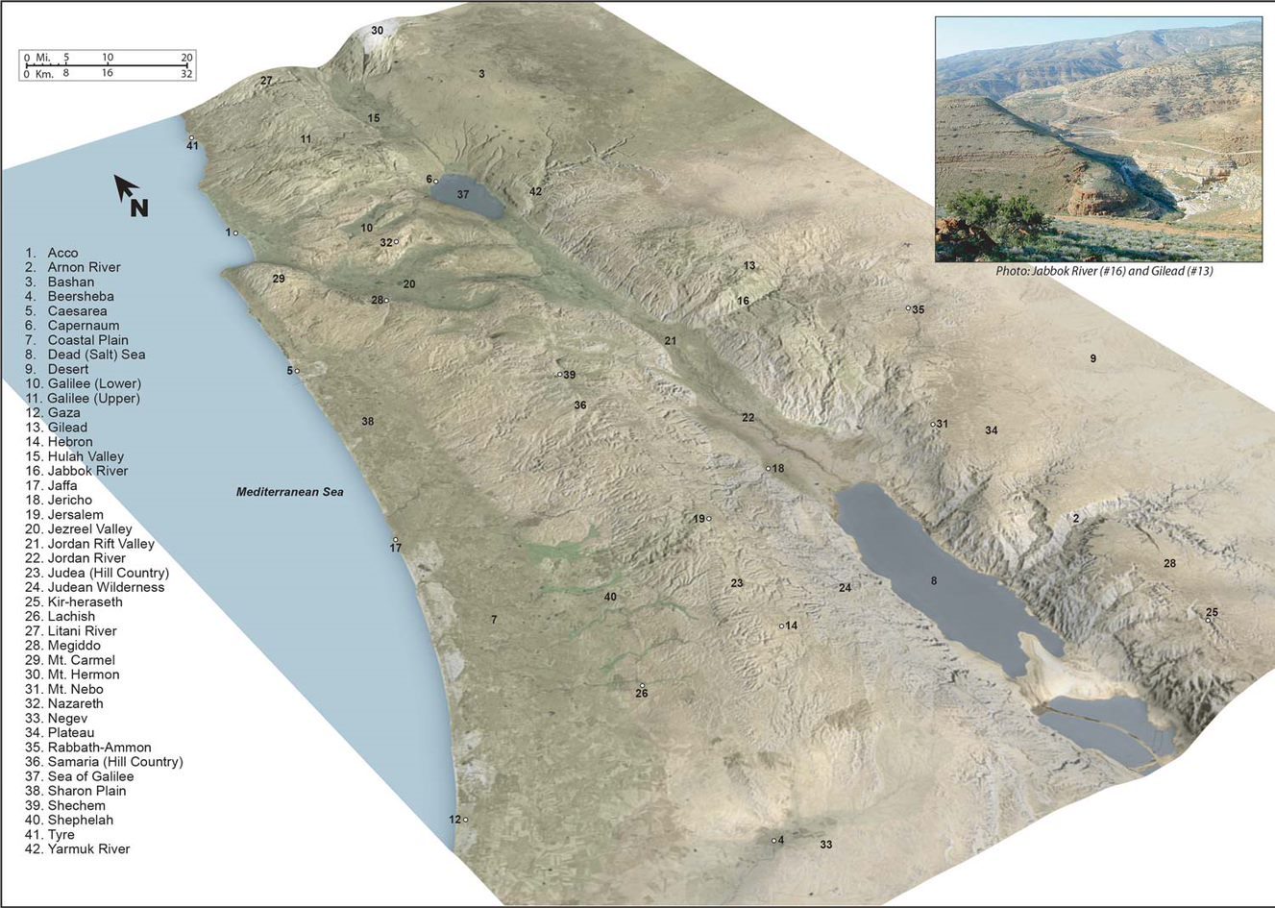

Slide 31
Highways & Geography

Slide 32
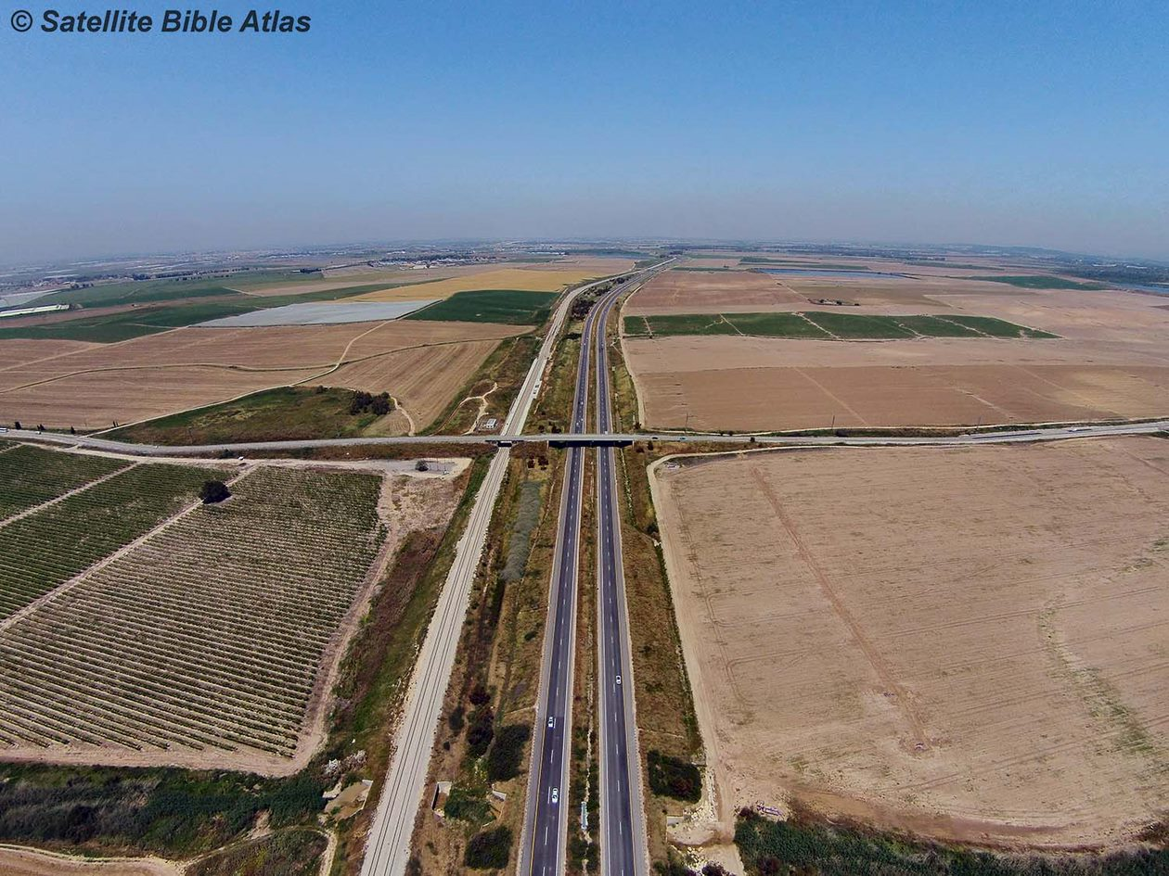
Coastal Plain

Slide 33
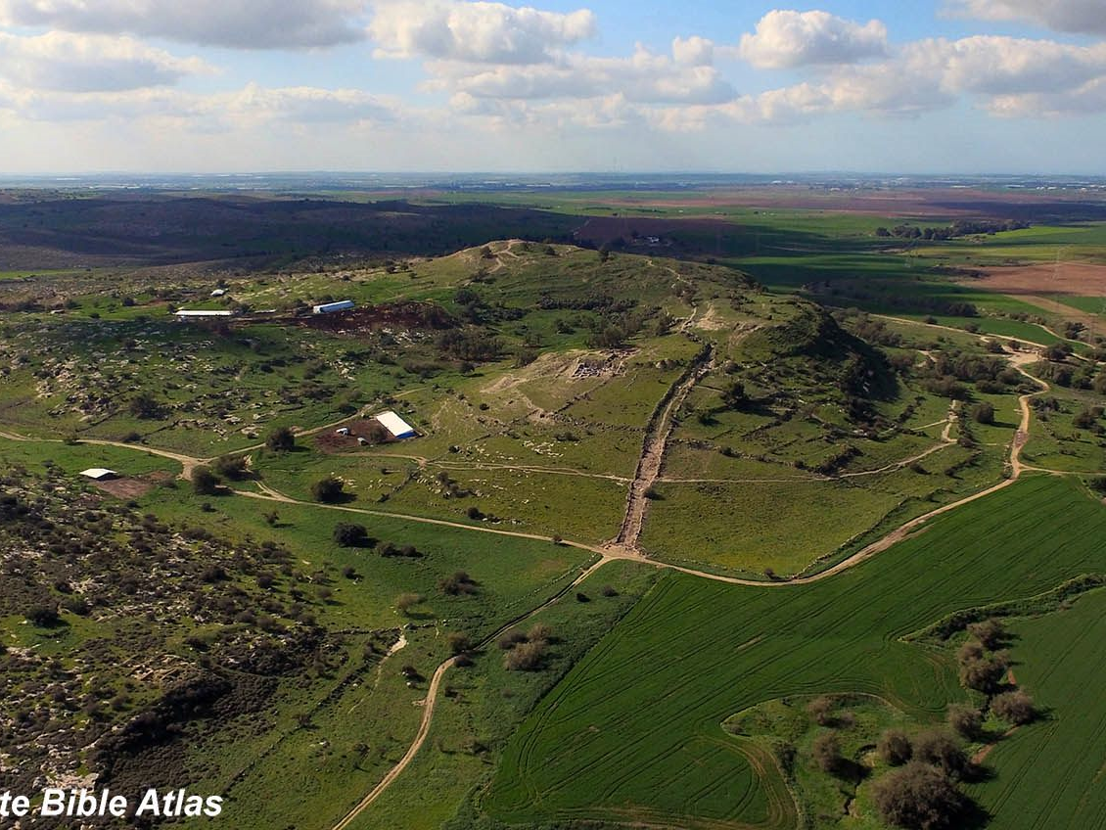
Coastal Plain

Slide 34
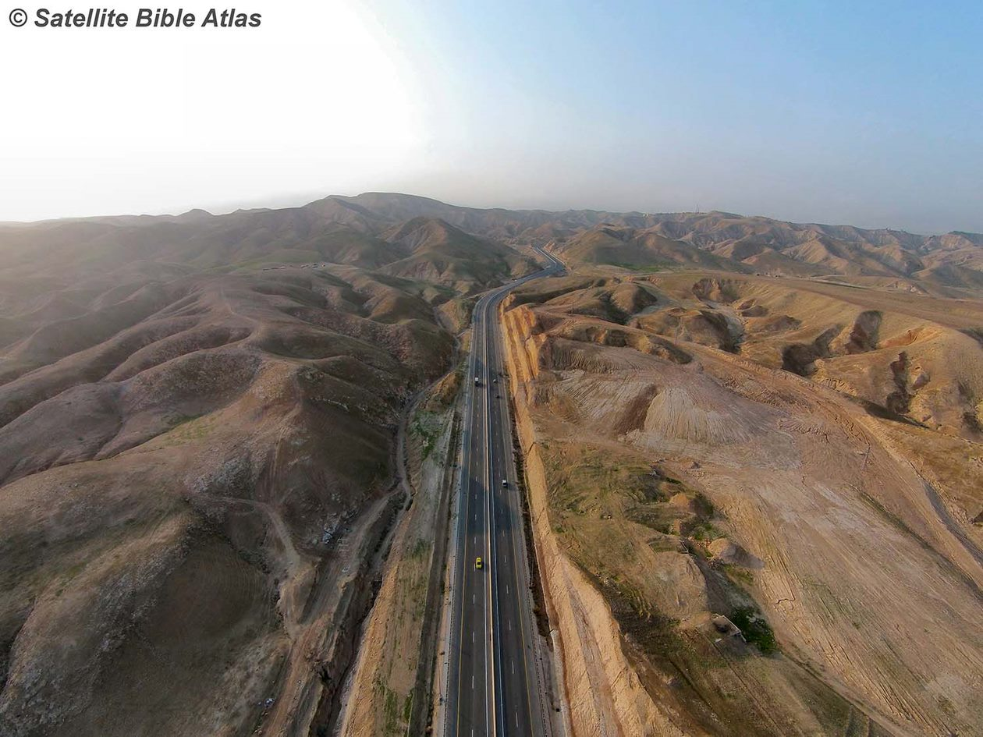
Hill Country

Slide 35
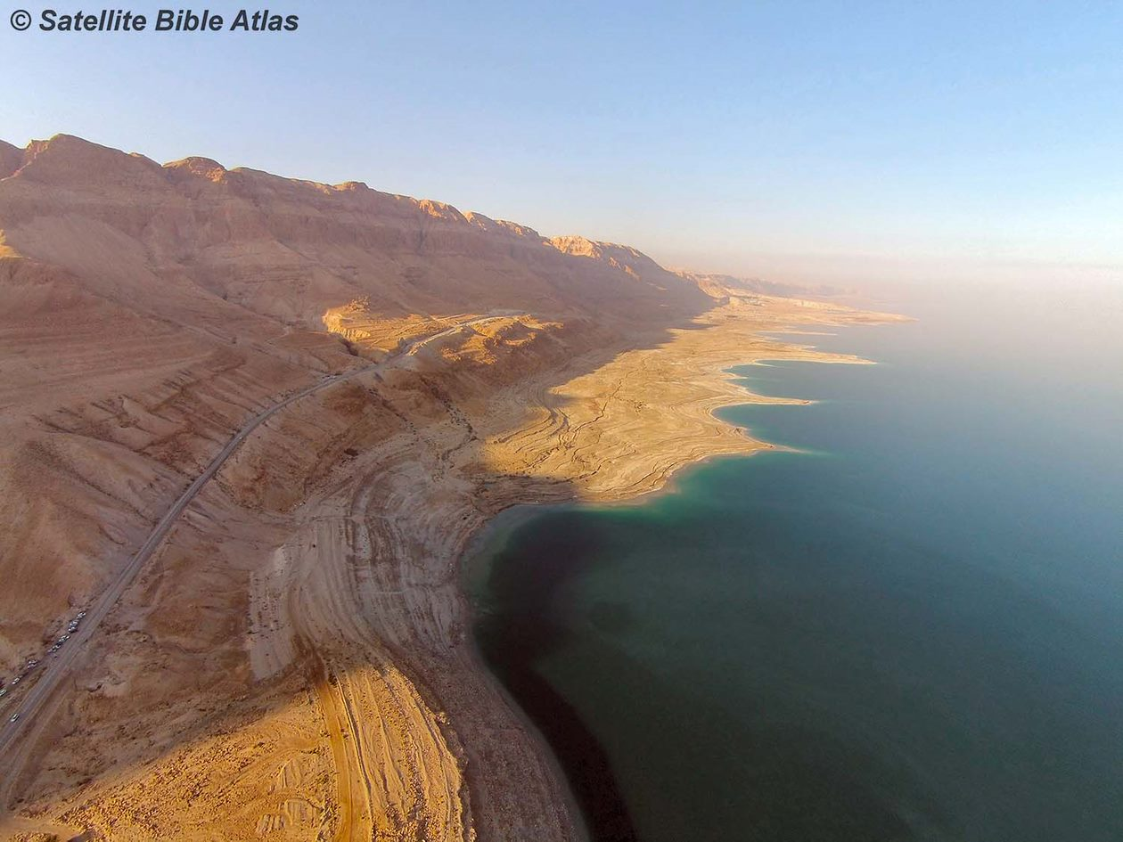
Jordan River – Dead Sea – Sea of Galilee

Slide 36
Jordan River – Dead Sea – Sea of Galilee

Slide 37
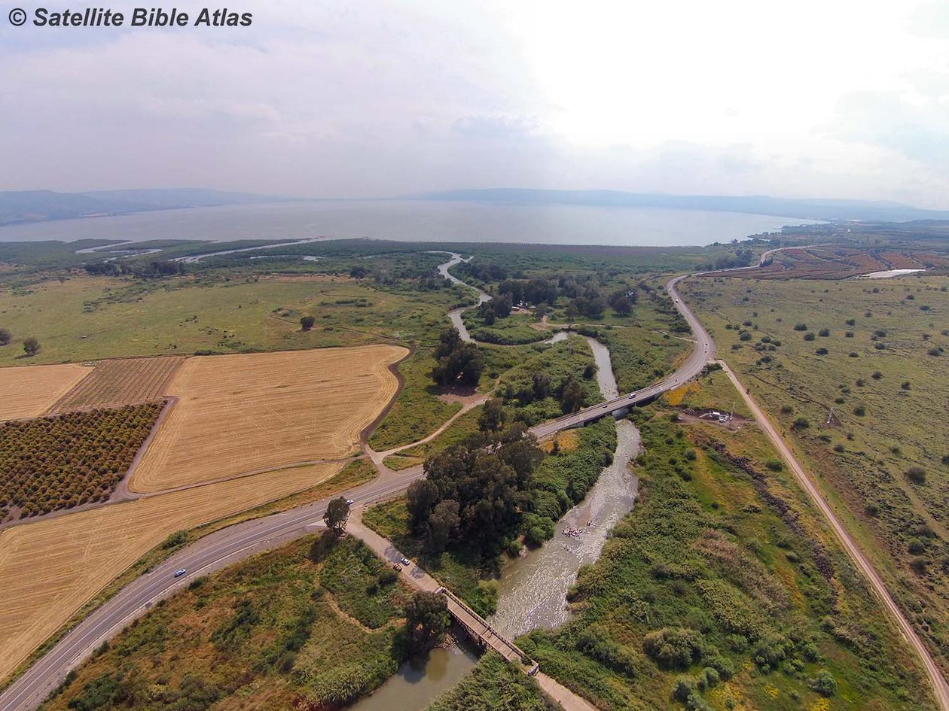
Jordan River – Dead Sea – Sea of Galilee

Slide 38
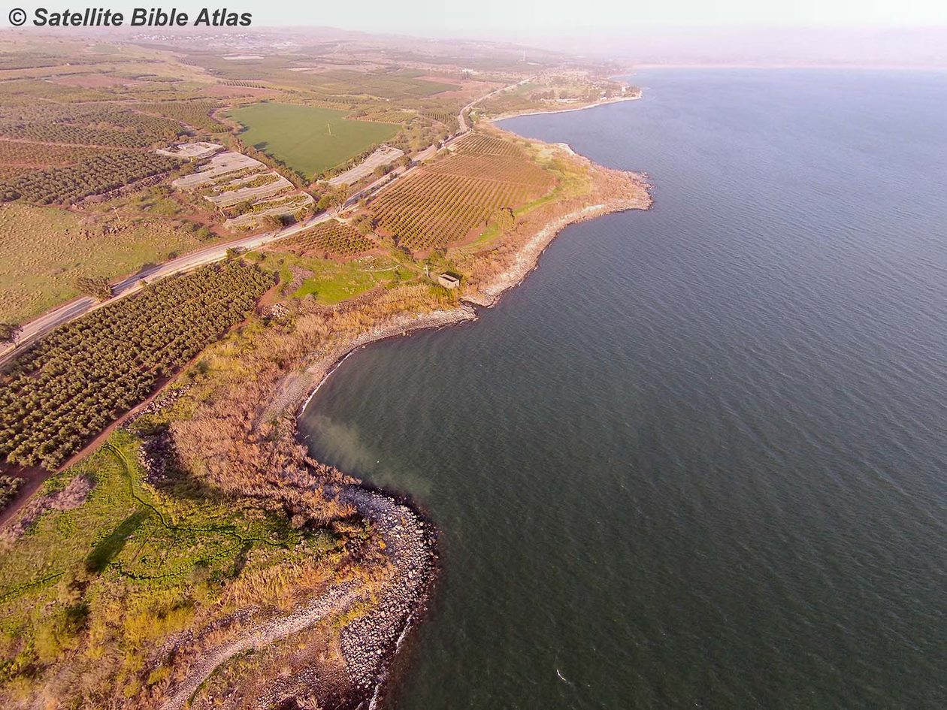
Jordan River – Dead Sea – Sea of Galilee

Slide 39
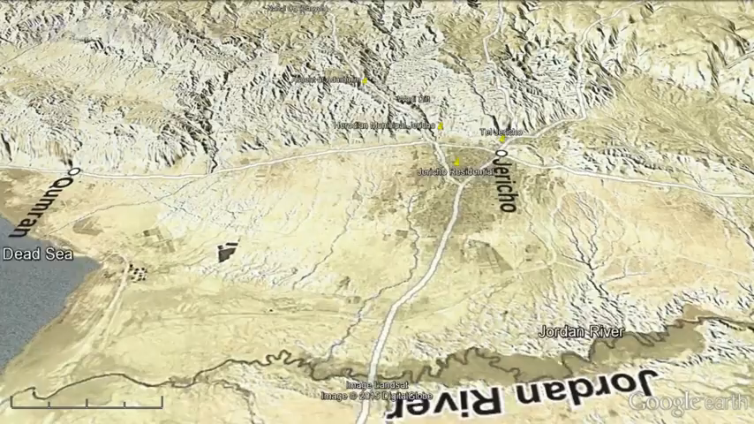
Why Study Geography?

Slide 40
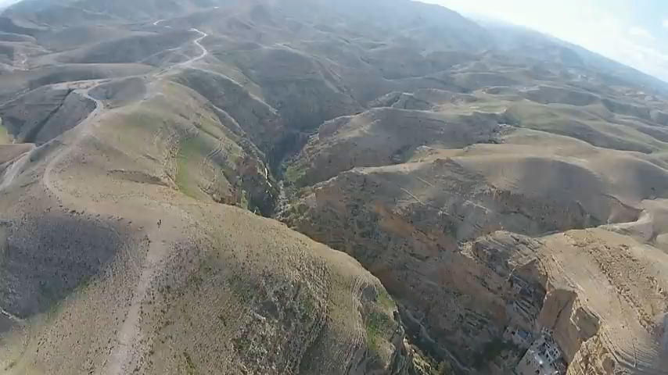
Why Study Geography?

Slide 41
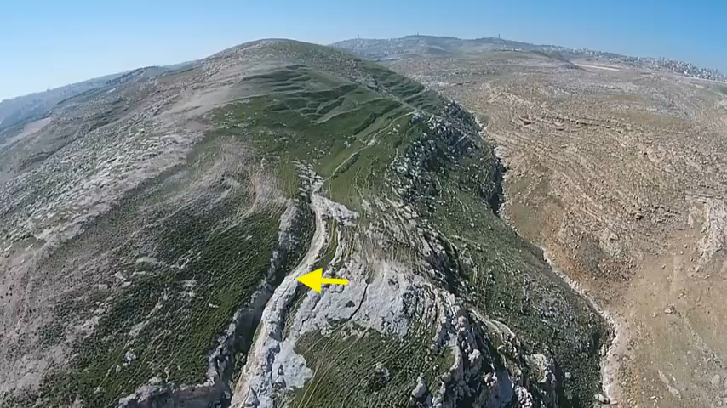
Why Study Geography?

Slide 42
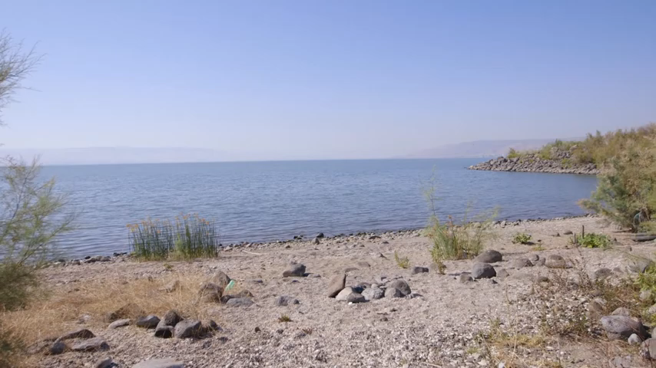
Why Study Geography?

